Slide 1
Enhanced Entity-Relationship (EER) Modeling

Slide 2
Introduction
Enhanced Entity Relationship (EER) model is an extension of the original ER model
Why do we need EER Model ?
Which concepts and relationships cannot be captured by ER Model ?

Slide 3
Supertype/Subtype relationships
Allows us to model a general entity type (the supertype) and then subdivide it into several specialised entity types (called subtypes)
Each subtype inherits from its supertype and may have special attributes of its own

Slide 4
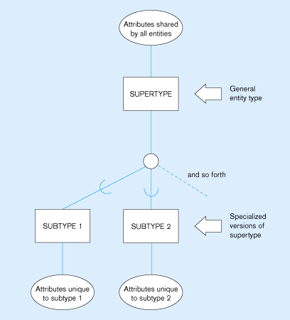
Basic notation for supertype/subtype relationships

Slide 5
An example: EMPLOYEE supertype
Suppose that an organisation has 3 types of employees:
Hourly:
Employee_Number, Employee_Name, Address, Date_Hired, Hourly_Rate
Salaried:
Employee_Number, Employee_Name, Address, Date_Hired, Annual_Salary, Stock_Option
Contract consultants:
Employee_Number, Employee_Name, Address, Date_Hired, Contract_Number, Billing_Rate

Slide 6
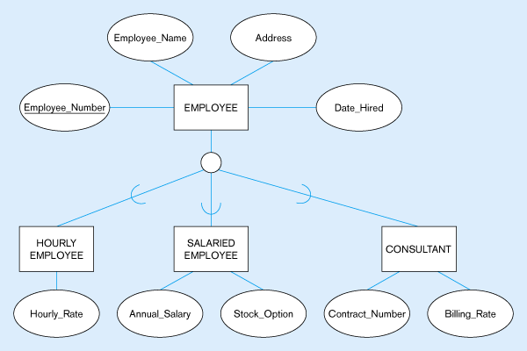
Employee supertype with three subtypes
All employee subtypes will have emp_no., name, address, and date-hired
Each employee subtype will also have its own attributes

Slide 7
Subclasses and Superclasses
An entity type may have different sub-groupings
Example: EMPLOYEE may be grouped into:
SECRETARY, ENGINEER, TECHNICIAN, …
MANAGER
SALARIED_EMPLOYEE, HOURLY_EMPLOYEE

Slide 8
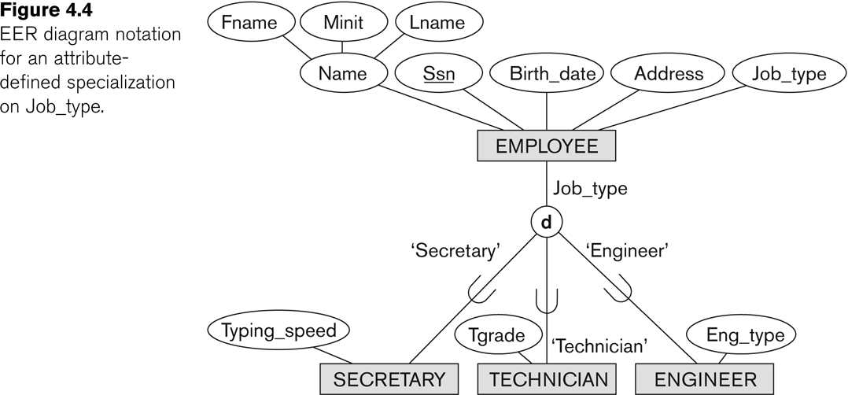
Subclasses and Superclasses

Slide 9
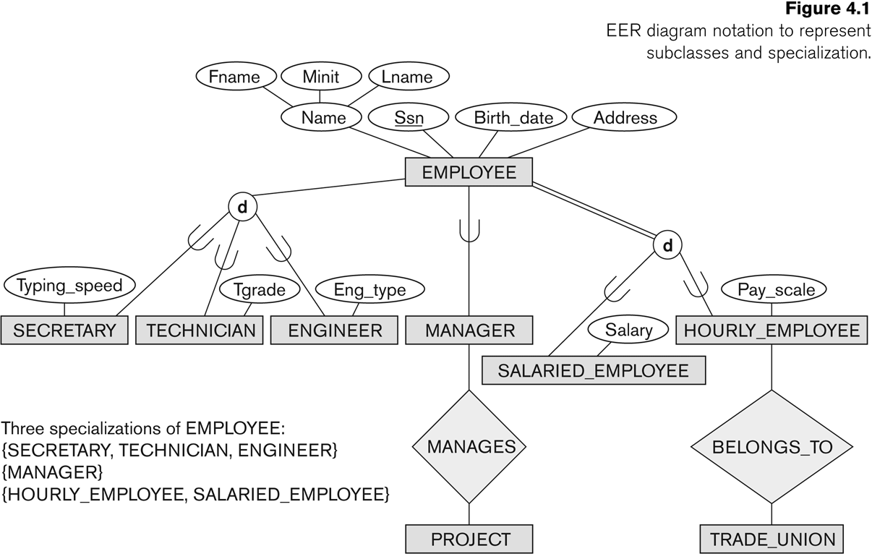
Subclasses and Superclasses
Notes:
Each of these subgroupings is a subset of EMPLOYEE entities
Each is called a subclass of EMPLOYEE
EMPLOYEE is the superclass for each of these subclasses
These are called superclass/subclass relationships:
EMPLOYEE/SECRETARY
EMPLOYEE/TECHNICIAN
EMPLOYEE/MANAGER

Slide 10
Attribute Inheritance in Superclass / Subclass Relationships
An entity that is member of a subclass inherits
All attributes of the superclass
All relationships of the superclass
Example:
The SECRETARY (as well as TECHNICIAN and ENGINEER) inherit the attributes Name, SSN, …, from EMPLOYEE
Every SECRETARY entity will have values for the inherited attributes
Superclass/Subclass Relationships are also called IS-A relationships
SECRETARY IS-A EMPLOYEE,
TECHNICIAN IS-A EMPLOYEE,

Slide 11
Subclasses and Superclasses
Examples:
A salaried employee who is also an engineer belongs to the two subclasses:
ENGINEER, and
SALARIED_EMPLOYEE
A salaried employee who is also an engineering manager belongs to the three subclasses:
MANAGER,
ENGINEER, and
SALARIED_EMPLOYEE
It is not necessary that every entity in a superclass be a member of some subclass

Slide 12
Subclasses and Superclasses
Notes:
Each of these subgroupings is a subset of EMPLOYEE entities
Each is called a subclass of EMPLOYEE
EMPLOYEE is the superclass for each of these subclasses
These are called superclass/subclass relationships:
EMPLOYEE/SECRETARY
EMPLOYEE/TECHNICIAN
EMPLOYEE/MANAGER

Slide 13
When to use supertype/subtype relations
We use subtypes when
There are attributes that apply to some (but not all) of the instances of an entity type
The instances of a subtype participate in a relationship unique to that subtype

Slide 14
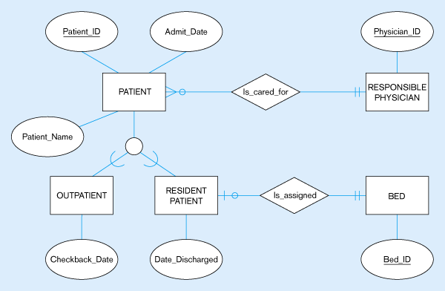
Supertype/subtype relationships of patients
Both outpatients and resident patients are cared for by a responsible physician
Only resident patients are assigned to a bed
Notes:
Every patient is cared for by a RESPONSIBLE_PHYSICIAN who develops a treatment plan for the patient
Each subtype also has unique attributes. Outpatients have a Checkback_Date, whilst residents have a Date_Discharged and a unique relationship that assigns each patient to a bed (this is a mandatory relationship, and each bed may or may not be assigned to a patient)

Slide 15
Generalization and specialization
Generalization
The process of defining a more general entity type from a set of more specialized entity types.
BOTTOM-UP
Specialization
The process of defining one or more subtypes of the supertype, and forming supertype/subtype relationships.
TOP-DOWN

Slide 16
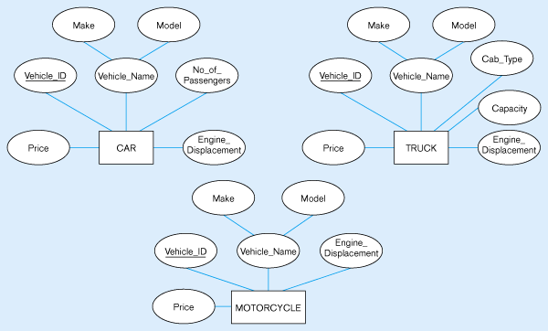
Example of Generalization
Three entity types: CAR, TRUCK, and MOTORCYCLE
All these types of vehicles have common attributes

Slide 17
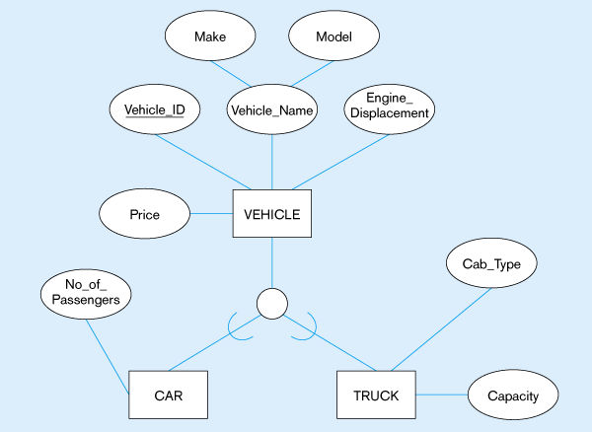
Generalization to VEHICLE supertype
So we put the shared attributes in a supertype
Note: no subtype for motorcycle, since it has no unique attributes

Slide 18
Specialisation
An entity type PART has attributes
Part_No, Description, Unit_price, Location, Qty_On_Hand, Routing_Number and Supplier
There may be more than one supplier
Some parts are internally Manufactured Parts while others are externally Purchased Parts
Some parts are obtained from both sources
The choice depends on factors such as manufacturing capacity, unit price of the parts etc.

Slide 19
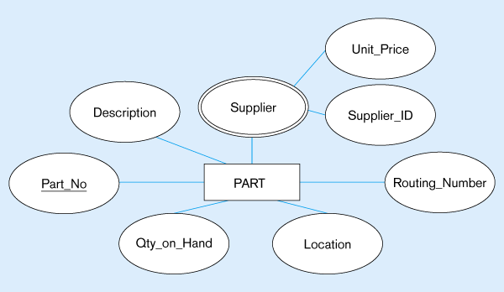
Example of Specialization
Entity type PART
Applies only to purchased parts
Only applies to manufactured parts
Notes:
Some attributes apply to all parts regardless of source
Some such as Routing_Number depend on the source as they apply only to Manufactured Parts.
This suggests that PART should be specialised by defining the subtypes
MANUFACTURED_PART and
PURCHASED_PART
A new relationship ‘Supplies’ has been created between PURCHASED_PART and SUPPLIER that allows users to more easily associate purchased parts with their suppliers
The attribute Unit_Price is now associated with the relationship ‘Supplies’ so that the price may vary between suppliers

Slide 20
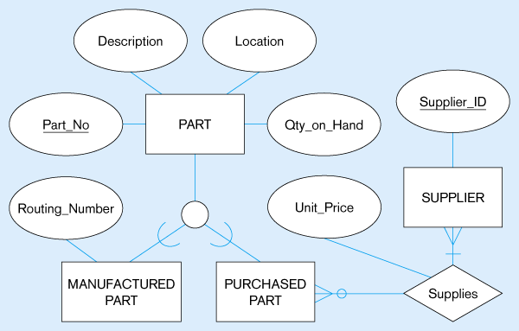
Specialization to MANUFACTURED PART and PURCHASED PART
Created 2 subtypes
(0,N)
(1,N)
Note: multivalued attribute was replaced by a relationship
to another entity
Notes:
A new relationship ‘Supplies’ has been created between PURCHASED_PART and SUPPLIER that allows users to more easily associate purchased parts with their suppliers
The attribute Unit_Price is now associated with the relationship ‘Supplies’ so that the price may vary between suppliers

Slide 21
Completeness constraints
Total Specialization: An entity instance of a supertype must also be a member of at least one subtype.
Partial Specialization : An entity instance of the supertype is allowed not to belong to any subtype.

Slide 22
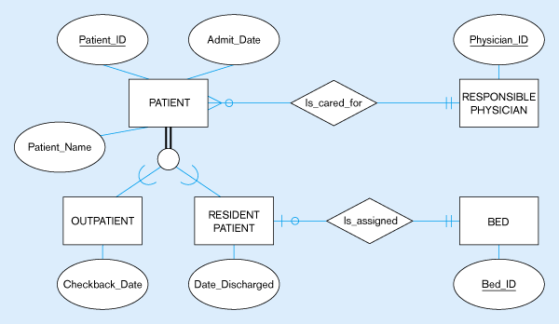
Examples of completeness constraints
Total specialization rule
(1,1)
(0,N)
A patient must be either an outpatient or a resident patient
(1,1)
(0,1)
Notes:
Yes (double line) In following Fig. A PATIENT must either be an OUTPATIENT or a RESIDENT PATIENT. Total specialisation is indicated by the double line extending from the PATIENT identity type to the circle

Slide 23
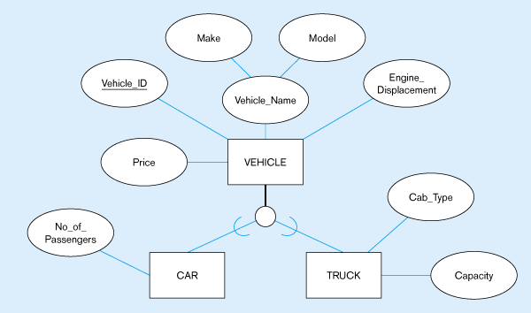
Partial specialization rule
A vehicle could be a car, a truck, or neither (motorcycle)
Notes:
Partial Specialization Rule: No (single line) An entity instance of the supertype is allowed not to belong to any subtype.
In the following Fig. If a VEHICLE is a car it will appear as an instance of CAR, and if a truck as an instance of TRUCK.
However, if the vehicle is a motorcycle it cannot appear as an instance of any subtype. This example of partial specialisation is specified by the single line from the VEHICLE supertype to the circle

Slide 24
Disjointness constraint
Can an instance of a supertype may simultaneously be a member of two (or more) subtypes?
Yes
We have two possibilities: Disjoint or Overlapping Subtypes

Slide 25
Disjointness constraint
Disjoint Rule: An instance of the supertype can be only ONE of the subtypes.
It is specified by the letter ‘d’
Example: At any one time a PATIENT must be either an outpatient or a resident patient but cannot be both
The subclass of a patient may change over time, but at any given time a patient is of only one type

Slide 26
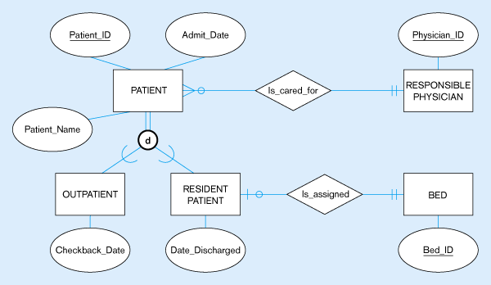
Examples of disjointness constraints
(1,1)
(0,N)
A patient can either be outpatient or resident, but not both
(1,1)
(0,1)

Slide 27
Disjointness constraint
Overlap Rule: An instance of the supertype can simultaneously be a member of more than one of the subtypes.
Example: Some PARTs are both Manufactured and Purchased.
An instance of PART is a particular Part Number (i.e. type of part) rather than the individual part itself.
Consider Part Number 4000, at a given time there may be 250 of this part to hand, of which 100 are manufactured and 150 are purchased.

Slide 28
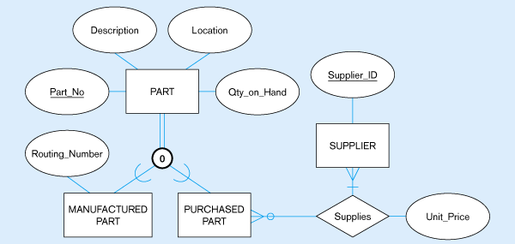
Overlap rule
A part may be both purchased and manufactured
(0,N)
(1,N)
Double line suggests any part must be either a purchased part or a manufactured part, or it may simultaneously be both of these

Slide 29
Specialization Example
Specialization of EMPLOYEE based on
method of pay
Job type
Attributes of a subclass are called specific or local attributes.
For example, the attribute TypingSpeed of SECRETARY
The subclass can also participate in specific relationship types.
For example, a relationship BELONGS_TO of HOURLY_EMPLOYEE

Slide 30
Specialization

Slide 31
Hierarchies & Lattices
A subclass may itself have further subclasses specified on it that forms a hierarchy or a lattice
A subclass inherits attributes of all its predecessor superclasses

Slide 32
Hierarchies
Hierarchy – subclass participates in one class/subclass relationship
EMPLOYEE
SOFTWARE ENGINEER has all the attributes of an ENGINEER and EMPLOYEE
U
U
SECRETARY
ENGINEER
single inheritance
Forms a tree structure
U
SOFTWARE ENGINEER

Slide 33
Lattices(shared subclass)
Lattice – subclass participates in more than one class/subclass relationship (multiple inheritance)
EMPLOYEE
U
U
U
SECRETARY
ENGINEER
MANAGER
U
U
ENGINEERING MANAGER (shared subclass) is a MANAGER and an ENGINEER
ENGINEERING MANAGER

Slide 34
shared subclass
A shared subclass is a subclass in:
more than one distinct superclass/subclass relationships
each relationships has a single superclass
shared subclass leads to multiple inheritance
EMPLOYEE
U
U
U
SECRETARY
ENGINEER
MANAGER
U
U
ENGINEERING MANAGER
Notes:
All of the superclass/subclass relationships we have seen so far have a single superclass

Slide 35
Categories (UNION TYPES)
Models a class/subclass with more than one superclass of distinct entity types. Attribute inheritance is selective.
PERSON
BANK
COMPANY
The category, OWNER, is a subclass of the union of PERSON, BANK, and COMPANY. OWNER is either a PERSON or a BANK or a COMPANY
U
U
OWNER

Slide 36
Categories (UNION TYPES)
In some cases, we need to model a single superclass/subclass relationship with more than one superclass
Superclasses can represent different entity types
Such a subclass is called a category or UNION TYPE

Slide 37
Categories (UNION TYPES)
Example: In vehicle registration database, a vehicle owner can be a PERSON, a BANK (holding a lien on a vehicle) or a COMPANY.
OWNER represents a subset of the union of the three superclasses COMPANY, BANK, and PERSON
A category member must exist in at least one of its superclasses
Difference from shared subclass, which is a:
subset of the intersection of its superclasses
shared subclass member must exist in all of its superclasses

Slide 38
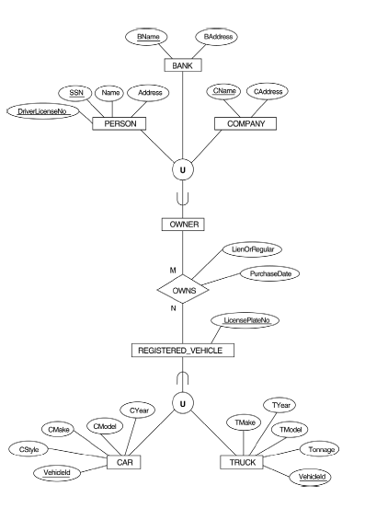
OWNER, REGISTERED_VEHICLE
A category can be total or partial
Total holds union of all entities in superclass
Partial holds subset of the union
If category is total then it can be represented by total specialization or generalization
What is the difference between VEHICLE and REGISTERED_VEHICLE ?

Slide 39
Defining supertype/subtype hierarchies
Let us model Human resources in a University
We have three types of resources: EMPLOYEE, STUDENT and ALUMNUS (already graduated). All three types have attributes such as SSN, Name, Address, Gender and BirthDate.
A person may belong to more than one subtype such as ALUMNUS and EMPLOYEE. Alumnus have degrees. And Employee gets salary.
The two major subtypes of Employee are: FACULTY and STAFF. There may be other types of employees. Each staff member have position and faculty member have rank. An employee cannot be both Faculty and Staff at the same time.
There are only two subtypes for student: GRADUATE and UNDERGRADUATE. For Graduate we record test-scores and for Undergrad we record class standing.
Notes:
so the overlap rule is used. Overlap allows for any overlap (3-way) so if certain combinations are not allowed a more refined supertype/subtype hierarchy would have to be developed to eliminate these

Slide 40
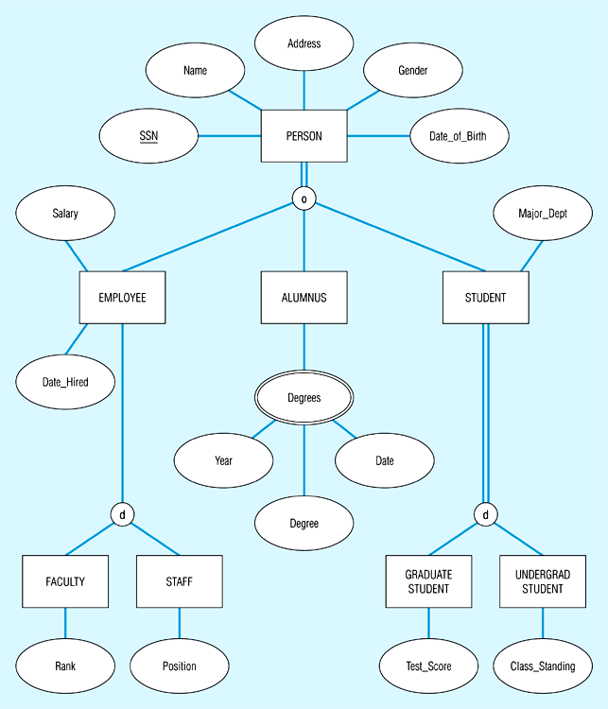
Example of supertype/subtype hierarchy

Slide 41
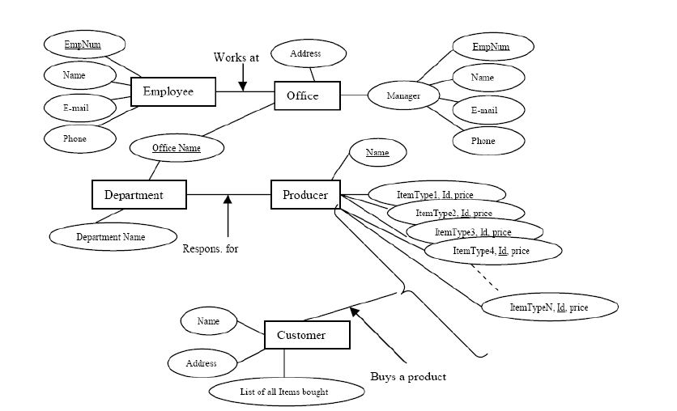
The diagram is supposed to model a company buying products from producers and selling to customers. Find errors ??
Notes:
• Relations are represented by a square with a name in it.
• You can’t connect entities with attributes.
• All entities must have a key attribute.
• Attributes can be composite, but they can’t have attributes of their own.
• Entities can’t share attributes
• The “Office name” attribute does not have anything to do with a department.
• The “Office name” attribute should be on the “Office” entity.
• It’s not possible to model the items like this, an entity can only have a finite number of attributes.
• The Customer attribute “List of all…” should not be an attribute on customer.
• “List of all…” should be an N:M relation.

Slide 42
Alternative diagrammatic notations
ER/EER diagrams are a specific notation for displaying the concepts of the model diagrammatically
DB design tools use many alternative notations for the same or similar concepts
One popular alternative notation uses UML class diagrams

Slide 43
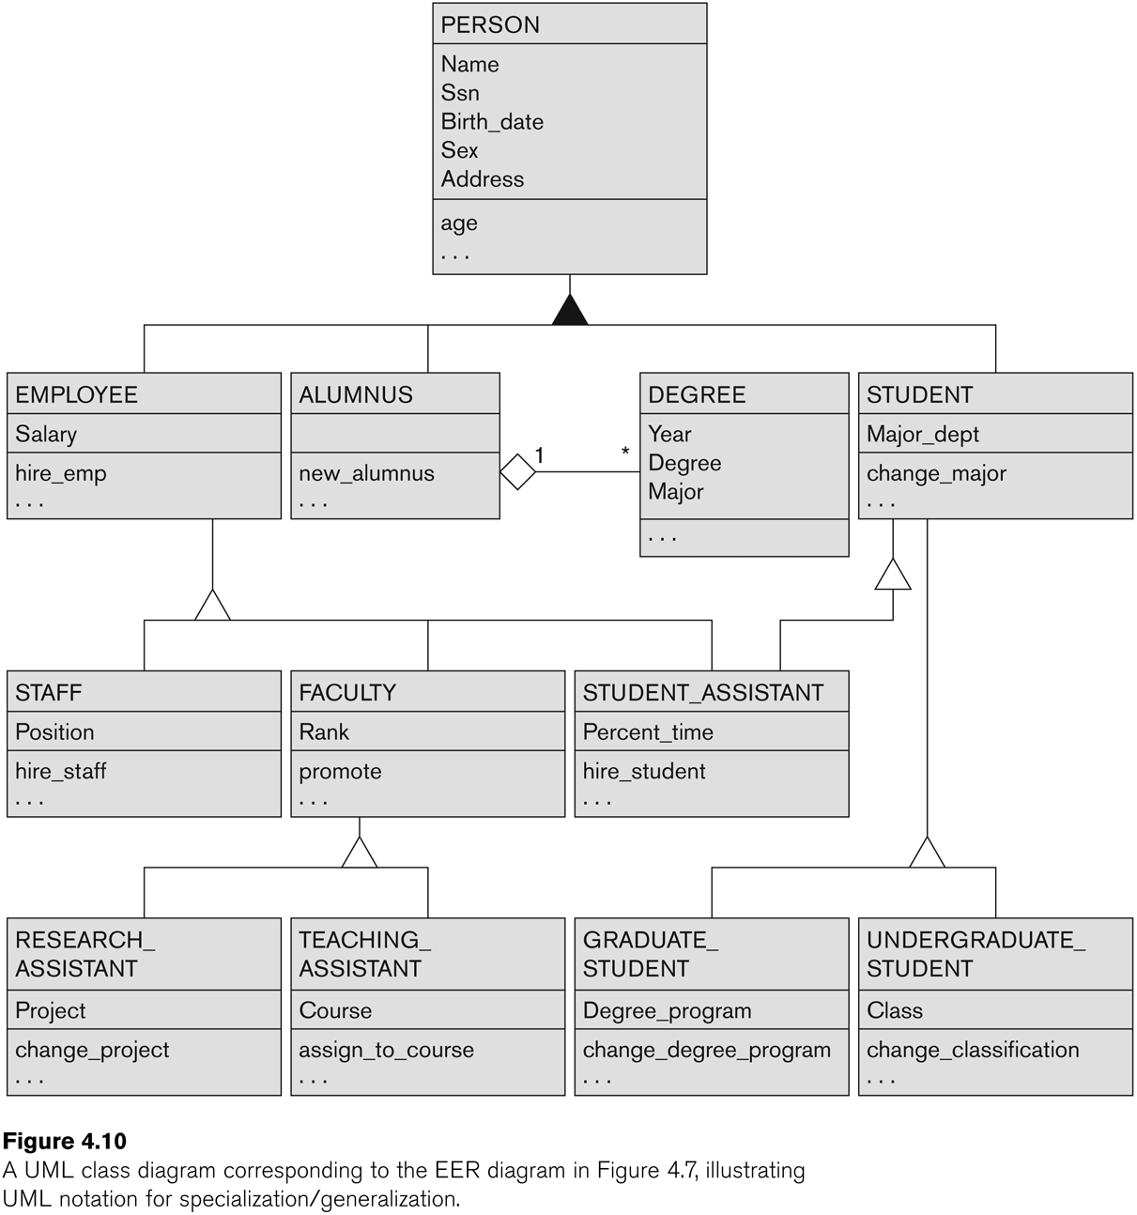
UML Example for Displaying Specialization / Generalization

Slide 44
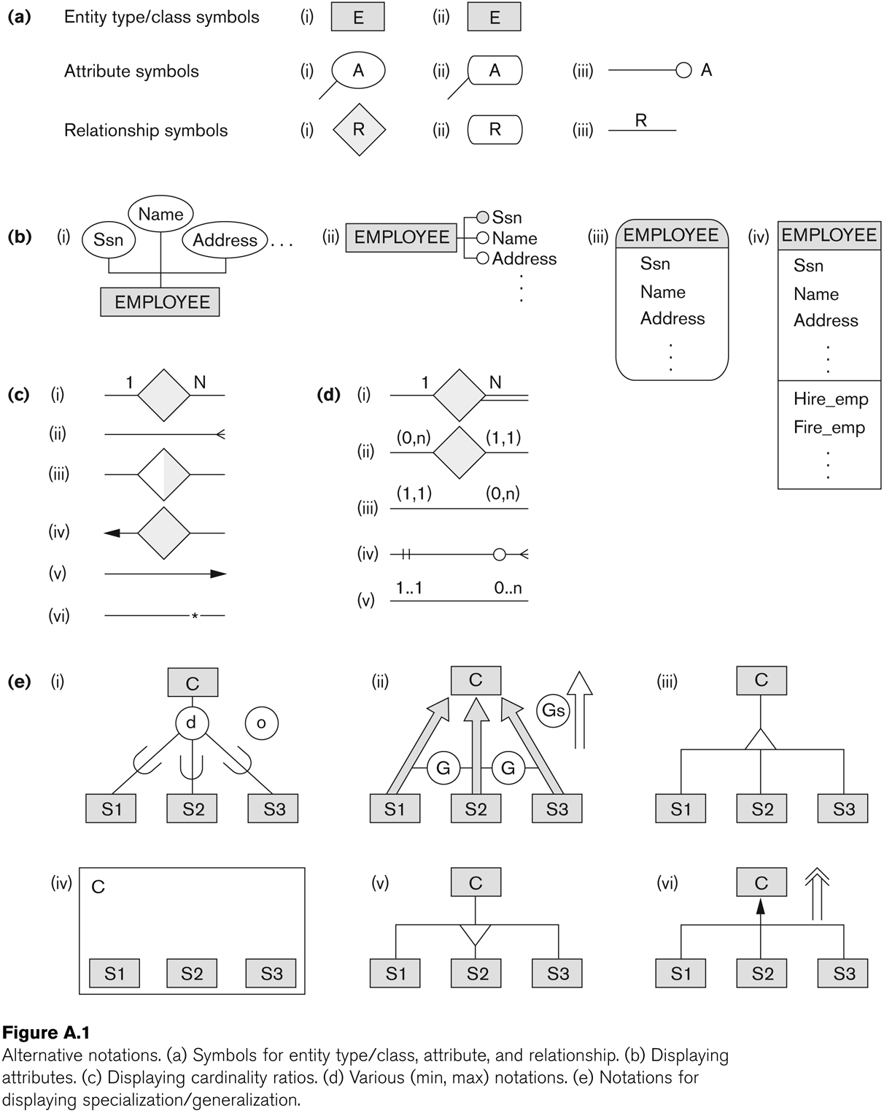
Alternative Diagrammatic Notations

Slide 45
General Conceptual Modeling Concepts
GENERAL DATA ABSTRACTIONS
CLASSIFICATION and INSTANTIATION
AGGREGATION and ASSOCIATION (relationships)
GENERALIZATION and SPECIALIZATION
IDENTIFICATION
CONSTRAINTS
CARDINALITY (Min and Max)
COVERAGE (Total vs. Partial, and Exclusive (disjoint) vs. Overlapping)

Slide 46
Ontologies
Use conceptual modeling and other tools to develop “a specification of a conceptualization”
Specification refers to the language and vocabulary (data model concepts) used
Conceptualization refers to the description (schema) of the concepts of a particular field of knowledge and the relationships among these concepts
Many medical, scientific, and engineering ontologies are being developed as a means of standardizing concepts and terminology

Slide 47
Summary
Introduced the EER model concepts
Class/subclass relationships
Specialization and generalization
Inheritance
These augment the basic ER model concepts introduced in Chapter 3
EER diagrams and alternative notations were presented

